Slide 1
Image Generation using GAN – Short Story Assignment
Aman Shah(015944279)

Slide 2
Table of content
Introduction
Basic Architecture
Generator
Discriminator
GAN Training
Demo

Slide 3
Introduction
Generative adversarial networks (GANs) are an exciting recent innovation in machine learning. GANs are generative models: they create new data instances that resemble your training data. For example, GANs can create images that look like photographs of human faces, even though the faces don't belong to any real person

Slide 4
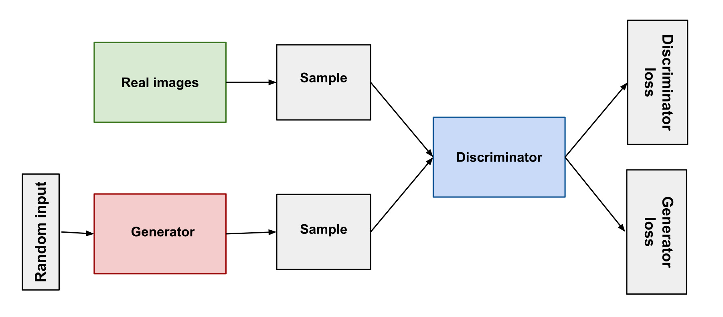
Basic architecture
A generative adversarial network (GAN) has two parts: The generator learns to generate plausible data. The discriminator learns to distinguish the generator's fake data from real data. Both the generator and the discriminator are neural networks. The generator output is connected directly to the discriminator input. Through backpropagation, the discriminator's classification provides a signal that the generator uses to update its weights.

Slide 5
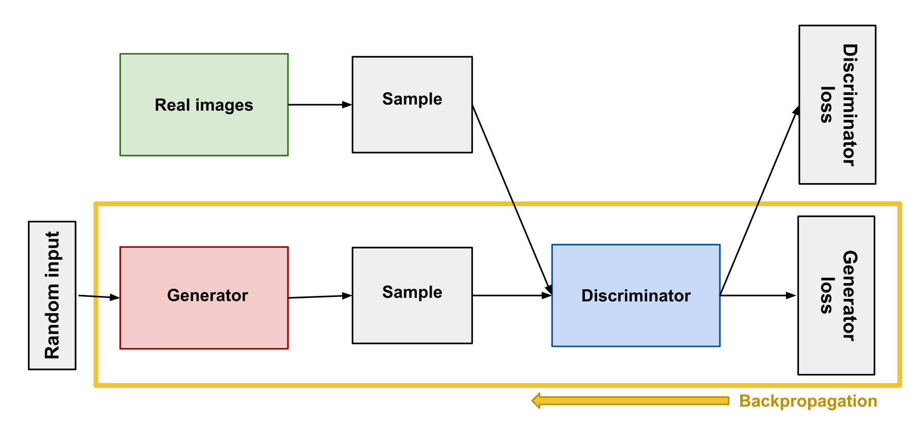
Generator
The generator part of GAN creates fake data, based on feedback received from discriminator. It’s goal is to achieve higher level of accuracy in fake data generated, such that discriminator is not able to distinguish between fake and real. Generator training needs more tighter integration between both as compared to discriminator training.

Slide 6
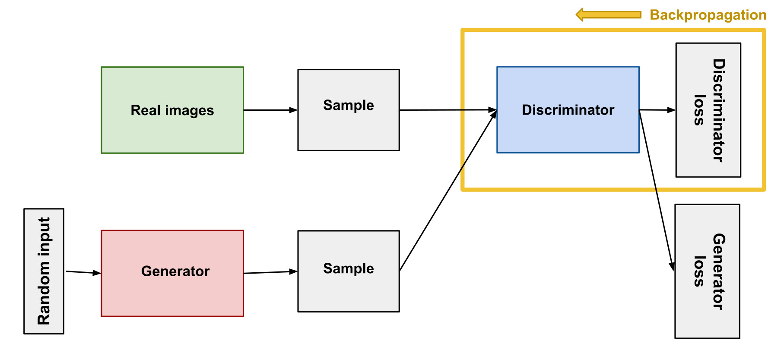
Discriminator
The discriminator works as a simple classifier. It tries to distinguish real data from the data created by the generator. It can utilize can kind of network architecture, depending on the type of data being fed.

Slide 7
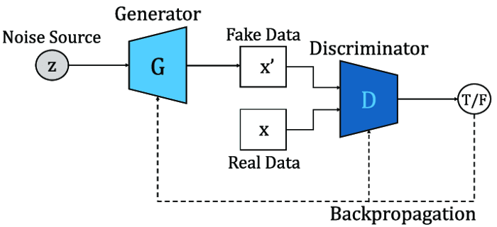
GAN Training
The training of both the models (the generator and the discriminator) is done simultaneously. The training is performed until the generator is able to fool the discriminator over a set threshold number of times. This way, we can be confident that the generator is able to generate realistic-looking data.

Slide 8
Demo

Slide 9
THANK YOU
Aman Shah(015944279)
aman.shah@sjsu.edu

